Slide 1
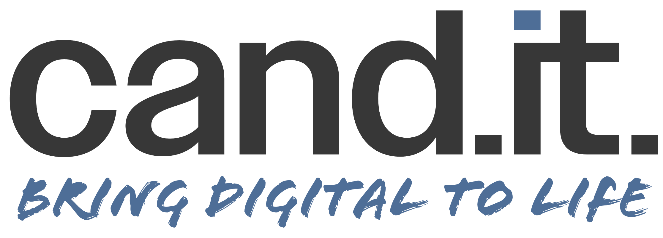



Dictionary for talking about cand.it.
A set of recommendations on how to describe cand.it. when communicating with potential employers.
TALK LESS ABOUT
Talk More ABOUT
TALK LESS ABOUT
Talk More ABOUT
Building bridges
A bridge connects two points and is by nature a static construction. So, while the concept seems positive, it comes off as a static compe-tence.
Being a connector
A connector is regarded a dynamic, flexible, and network-oriented person. This fits well with what most companies are looking for.
Innovation
Innovation isn’t a bad word, but in the current economic climate a lot of companies are dialing down their innovation efforts.
Adaptability
Companies know things aren’t static so the ability to adapt is still in high demand. This fits well with cand.it.’s role as change agents.
IT
The term is covered in the cand.it. title, and many companies associate IT with quite strong technical competences.
Digital
Digital represents the ability to put IT into a business context, which is why the word is very positively received among companies.
Theoretical competences
Companies know they’re getting an academic profile when hiring a graduate. But it’s rarely the theoretical skills that are most important.
A pragmatic approach
Cand.it.-graduates can bring knowledge in play, build relations, and make things happen. This kind of pragmatism is in high demand.
Interdisciplinarity
Most companies do not use this term in their job descriptions, and small- and mid-sized companies will perceive it a bit too academic.
Collaboration
The outcome of being interdisciplinary is the ability to collaborate in projects and work across the organisational structures.
Structure
Most graduates have learned to think and work in a structured manner, but for companies this isn’t a particular force on its own.
Progression
The value of structure is the ability to create overview and ensure progress in projects. Both are strong capabilities in the corporate world.
Cand.it. being a ’broad’ degree
Having a generalist educational profile isn’t all positive. On the contrary, for some employers it will make you appear a bit flaky.
Curiosity and outlook
You should instead talk about the value of a comprehensive education that has fed your curiosity and given a strong business outlook.
Group work
Working in groups during your education gives you valuable learnings in terms of collaboration and applying yourself in a group of people.
Project work
Companies talk about project work, not group work. So, highlight instead your experience with participation in – and maybe leading – projects.
WWW.CAND-IT-VEST.DK
The recommendations in this ’dictionary’ have been gathered through the qualitative and quantitative studies that were carried out prior to the launch of the campaign ‘Bring digital to life’ that targets potential employers of cand.it.-graduates.
JUNE 2023

